Slide 1


Facial Recognition System with Anti-spoofing measures and Liveness Detection Models
Supervised by Dr. M. Wahby
July 2022

Slide 2
Main Points
Brief introduction
Datasets used and their information
Liveness Models used and our experimental results.
System overview

Slide 3
Introduction
Our Project is a facial identification system with anti spoofing measures and liveness detection models.
All said measures will be fully discussed in addition to our experimentation results and our model choice.

Slide 4
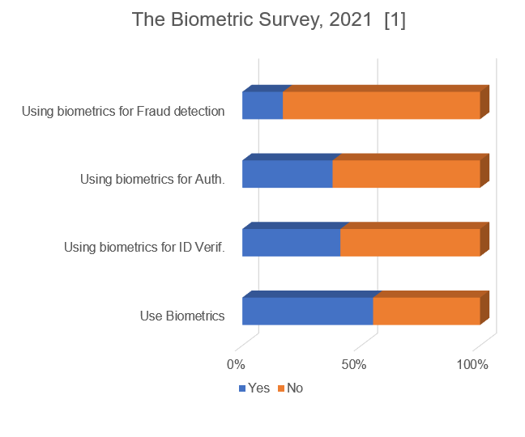
Introduction
According to a survey [1] , 55% of respondents said that their company is using biometrics today. Of them:
69% use the technology for authentication.
75% use it for identity verification.
31% for fraud detection.

Slide 5
Introduction
A survey of 500 IT Professional in 2018 [2] revealed that fingerprint scanning is the most common form of biometric authentication followed by facial recognition technology, which is used in 14% of organizations using Biometrics for authentication.
As this technology grows it calls for the need of robust antispoofing measures and system.

Slide 6
Datasets
In this Section we will talk about the datasets we have used and their properties.

Slide 7
Datasets
Until recent years, there was a lack of publicly available face anti-spoofing databases. The 3 most commonly used in research are:
REPLAY-ATTACK Dataset
CASIA-FASD
MSU-MFSD
We have managed to get access to the last two.

Slide 8
CASIA-FASD
Each subject’s samples are divided into | Low Quality | Real
 |  | Print warped
 |  | Cut
 |  | Replay
 | Medium Quality | Real
 |  | Print warped
 |  | Cut
 |  | Replay
 | High Quality | Real
 |  | Print warped
 |  | Cut
 |  | Replay
The CASIA face anti-spoofing database contains short videos of both real and spoofing attack attempt of 50 subjects 20 in train, 30 in test. Samples were acquired with three devices with different qualities:
Low quality, with an old 640x480 USB webcam
Medium quality, modern 480x 640 USB web camera
High quality, 1920 x1080 Sony NEX-5 high-definition camera.

Slide 9
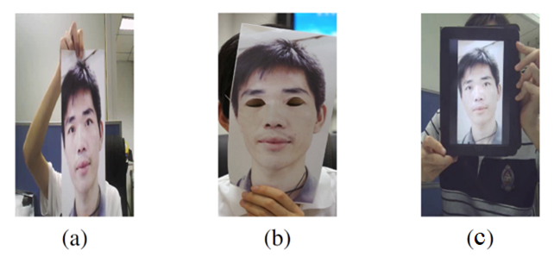
CASIA-FASD
Three different attacks are considered in this database:
Warped: curved hard copies of digital photographs of genuine subjects are used to gain illegal access
Cut: the attacks are performed as before, but the eye region in the hard copies have been cut out and the face of the attacker is placed behind, to forge eye blinking
Video: using an iPad, videos of the genuine users are replayed.
Hence, each subject has 12 sequences, 3 genuine and 9 fake ones. The overall number of sequences in the database is 600.

Slide 10
MSU-MFSD
Each subject’s samples are divided into | Laptop Camera | Real
 |  | Print
 |  | Phone Replay
 |  | HD iPad replay
 | Phone Camera | Real
 |  | Print
 |  | Phone Replay
 |  | HD iPad replay
The public available MSU MFSD Database for face spoof attack consists of 280 video clips of photo and video attack attempts to 35 clients (15 train, 20 test).
This Database was produced at the Michigan State University Pattern Recognition and Image Processing (PRIP) Lab, in East Lansing, US.
Two types of cameras were used in collecting this database:
1) built-in camera in MacBook Air 13’± (640x480);
2) front-facing camera in the Google Nexus 5 Android phone (720x480).

Slide 11
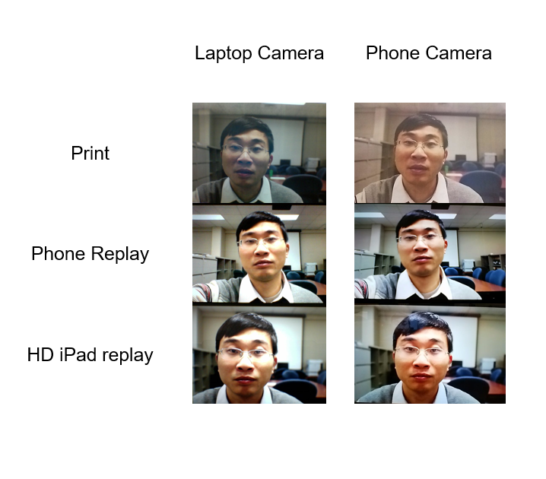
MSU-MFSD
Three types of spoof attacks were generated, using three different spoof medium to manifest the client’s biometry:
a) high-resolution replay video attacks using an iPad Air screen, with resolution of 2048x1536
b) mobile phone replay video attacks using an iPhone 5S screen, with resolution of 1136x640
c) printed photo attacks using an A3 paper with fully-occupied printed photo of the client’s biometry, paper size: 11' x 17', printed by a HP Color Laserjet CP6015xh with 1200 x 600 dpi;

Slide 12
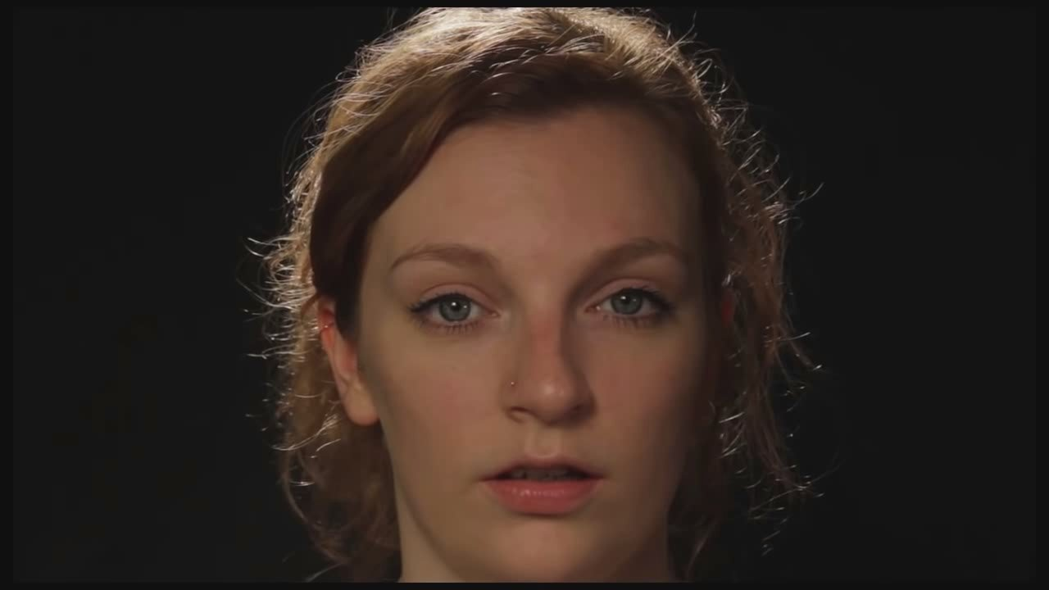
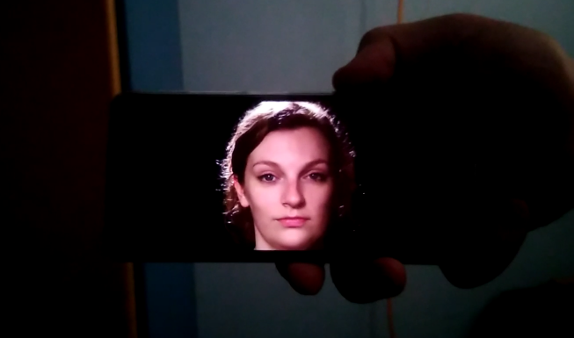
Generated Dataset from YouTube
Real
Replay
The original video ”The Stare” contains 21 minutes of 21 different subjects looking at the camera. The video was split according into sub clips by subject.
The replay attack data was captured using a Huawei Y7 (2019) front facing camera with the video replay on a Redmi note 11 AMOLED screen. The data was then split in DaVinci Resolve according to subject and then further split into 7 to 10 second clips.

Slide 13
Liveness Models
In this Section we will talk about the two types of models we have tested and their Architecture and experimental results.

Slide 14
Liveness Models
Frame based models:
Face Antispoofing Method Using Color Texture Segmentation:
Using CNN Model
Using FC DNN Model
Video based models:
Volumetric CNN using Conv3d and Maxpool3D layers.
Spatio-temporal Mapping into a CNN model.

Slide 15
Frame Based Models
Face Antispoofing Method Using Color Texture Segmentation Preprocessing:
Convert image from RGB color space to HSV and YCbCr color spaces RGB is a color space commonly used for sensing and displaying color images. However, its use in image analysis is typically limited because the three colors (red, green, and blue) are not separated according to luminance and color difference information.

Slide 16
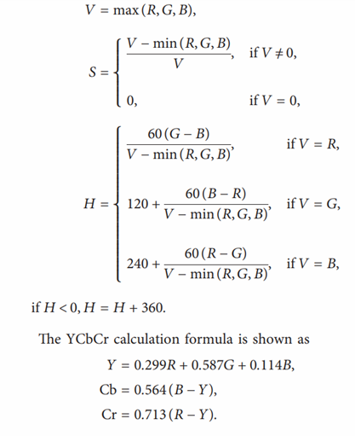
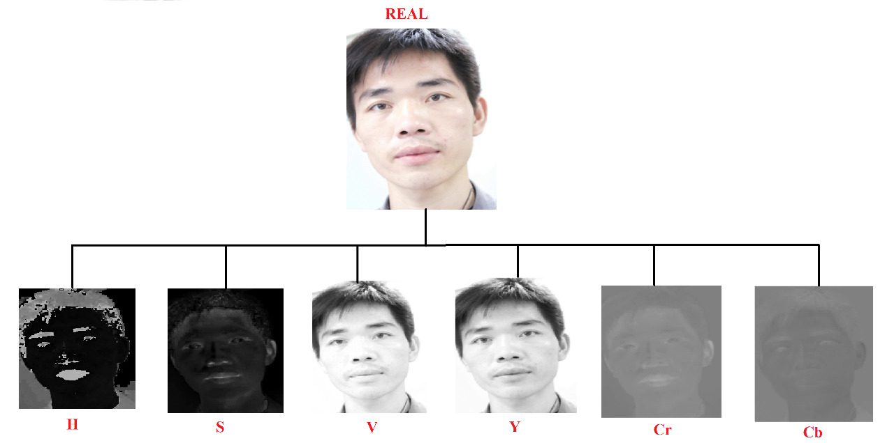
Frame based models

Slide 17
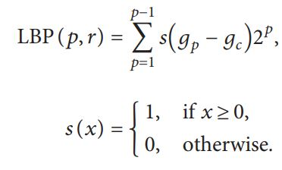
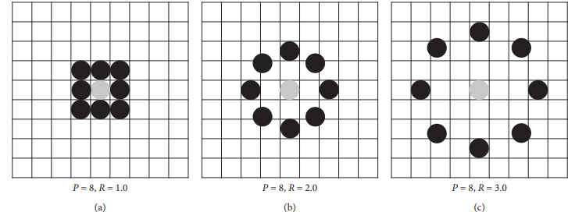
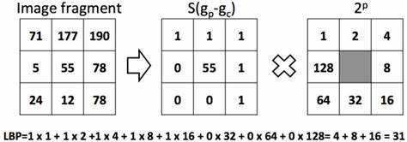
Frame based models
Preprocessing for model
Apply Local Binary Pattern on S , V and Cb channels.

Slide 18
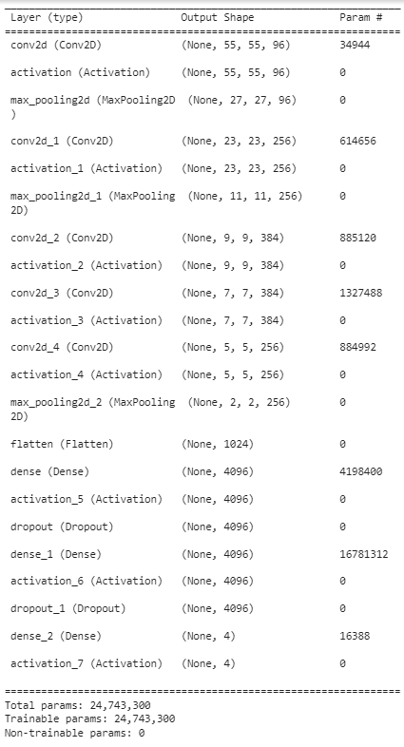
Frame based models: CNN training
Extract images from CASIA dataset videos.
Extracting faces from images using a pretrained face recognition model which will be later discussed.
Convert face from RGB to HSV and YCBCR color spaces.
Apply LBP on S , V and Cb.
Merge LBP of S , V and Cb into a single 3-channel image then feed it as training input for CNN.

Slide 19
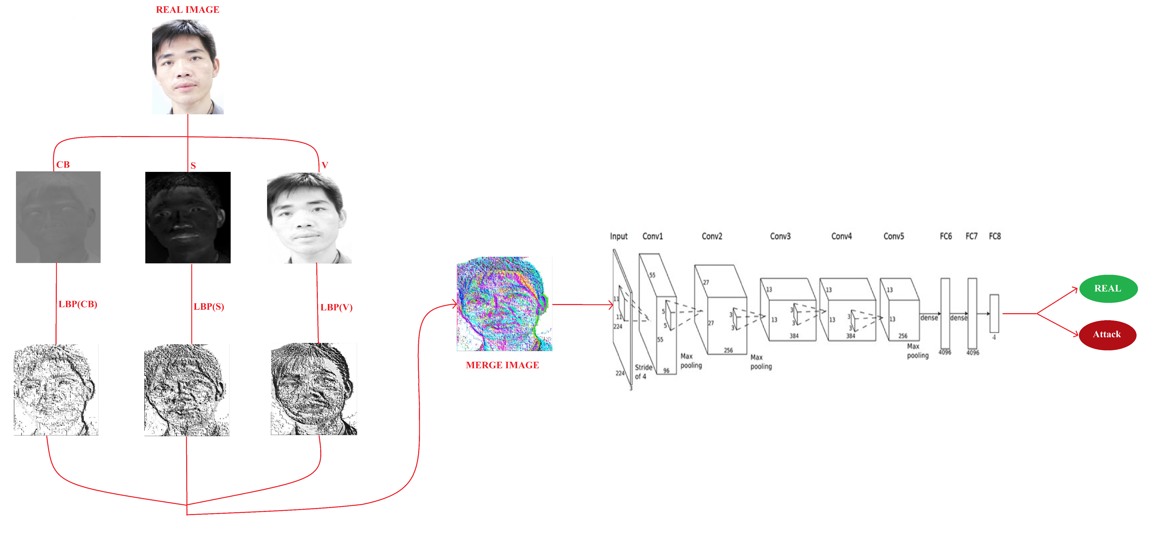
Frame based models: CNN

Slide 20
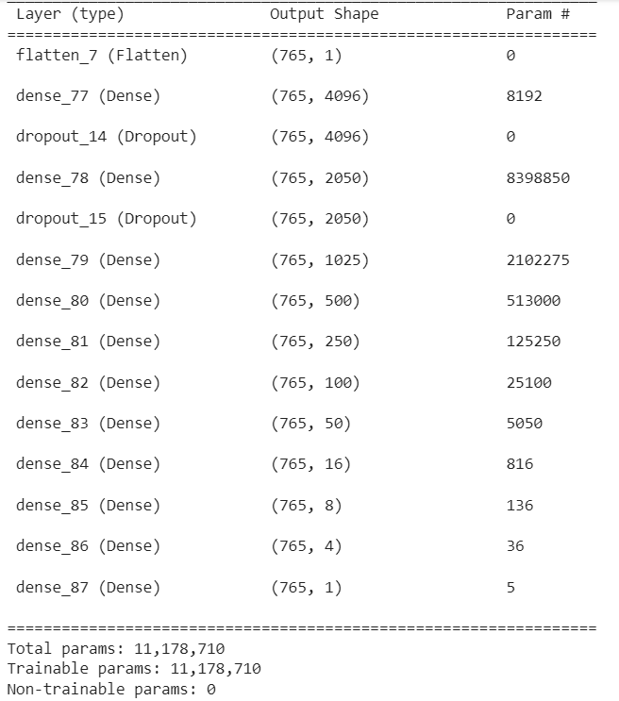
Frame based models: FC DNN training
Extract images from CASIA dataset videos.
Extracting faces from images using a pretrained face recognition model which will be later discussed.
Convert face from RGB to HSV and YCBCR color spaces.
Apply LBP on S , V and Cb.
Calculate histogram of LBP of S , V and CB to create one feature vector then feed it as input for FC DNN

Slide 21
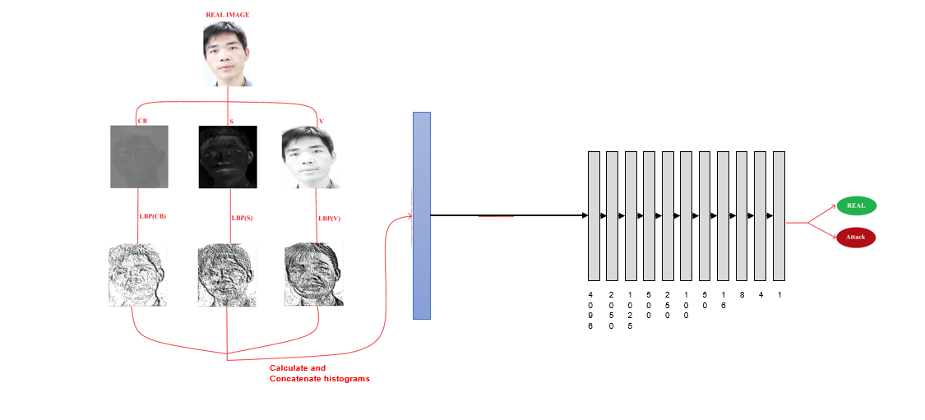
Frame based models: FC DNN

Slide 22
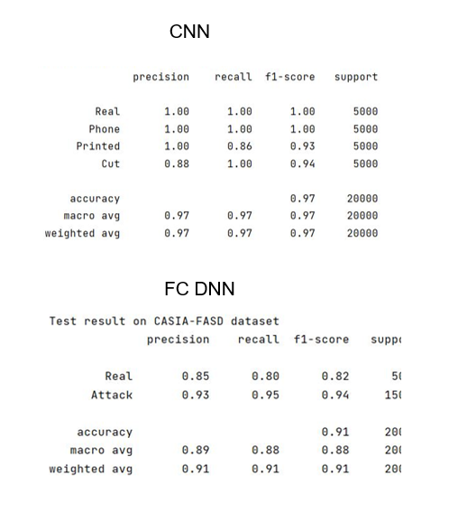
Frame based models: Results
The results of CNN model were very good as it scored On training, an accuracy rate of 99.5%, and when tested on both CASIA and MSU-MFSD, it scored an accuracy rate of 97%.
The results of FC DNN model were tested on the CASIA-FASD data set, it scored an accuracy rate of 91%

Slide 23
Video Based Models
Primary preprocessing:
Videos are Split into sub clips(each containing 24 frames) for standard operation.
Secondary processing is unique to each Model:
First we get the ROI of the face (and stabilize it) using a pretrained face detection model.
Sexond: we use bounding box expansion in both models with different parameters.

Slide 24
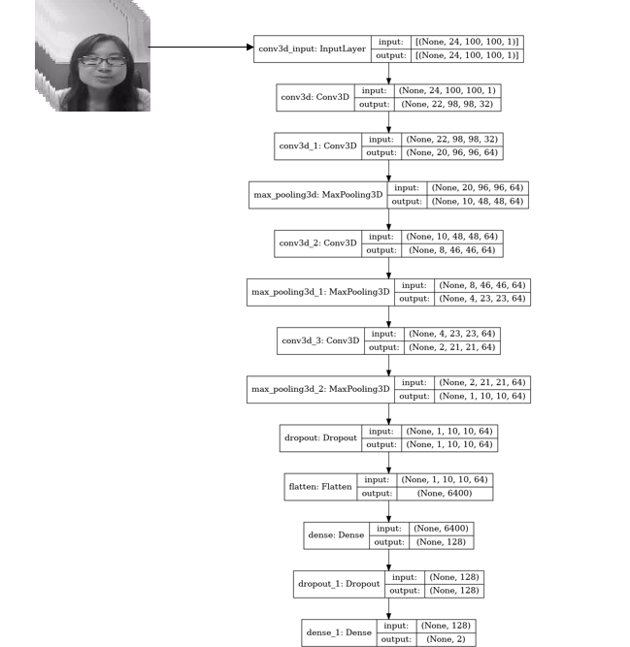
Video Based Model Volumetric CNN
Bounding box is expanded by 100% of dimensions
All the extracted regions are converted to grayscale and resized to 100*100
Histogram equalization is then preformed to correct illumination.
The data is then fed into the Model
The model was trained on the Train Part of the CASIA-FASD with:
LR Reduction On Plateau & Model Checkpoint.
With checkpoint restoration every 30 epochs.

Slide 25
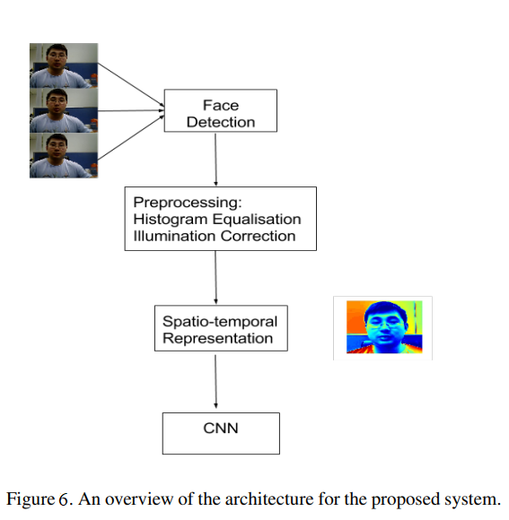
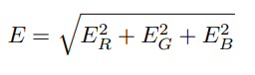
Video Based Model SpatioTemporal Mapping
Bounding box is expanded by 20% of dimensions
All the extracted regions are resized to 64 x 64
Histogram equalization is then preformed to correct illumination.
A bandpass equirpple filter is applied to the data.
Total energy is calculated from ESD of each channel
The SpatioTemporal representation is then fed into the Model

Slide 26
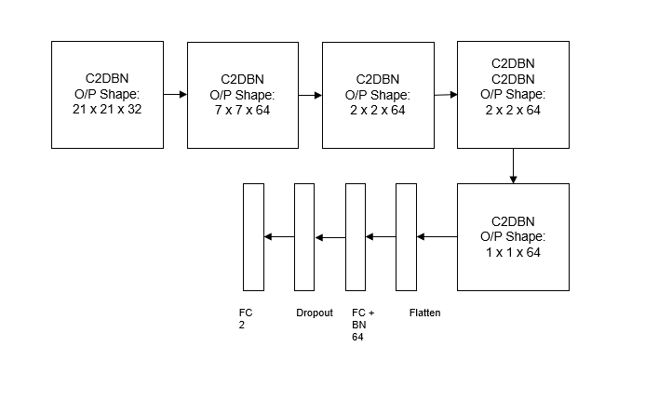
Video Based Model CNN
Each C2DBN Block is a Conv2D followed by Batch Normalization followed by ReLU activation sometimes followed by Maxpool2D.
The model was trained on the Train Part of the CASIA-FASD with:
LR Reduction On Plateau & Model Checkpoint.
With checkpoint restoration every 300 epochs.

Slide 27
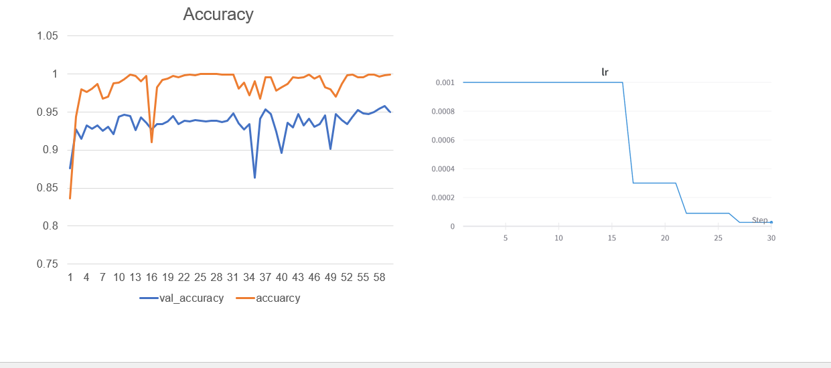
Video Based Model VCNN Training Graphs

Slide 28
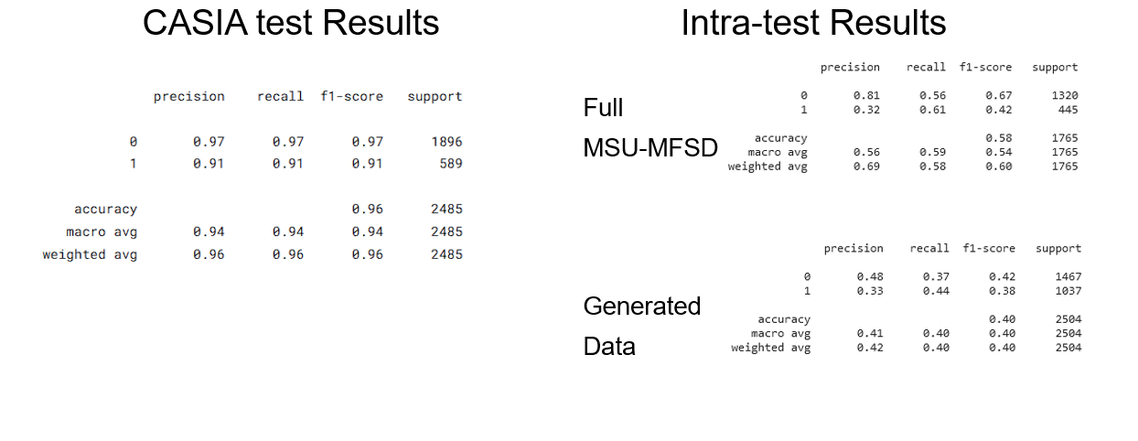
Video Based Model Results VCNN

Slide 29
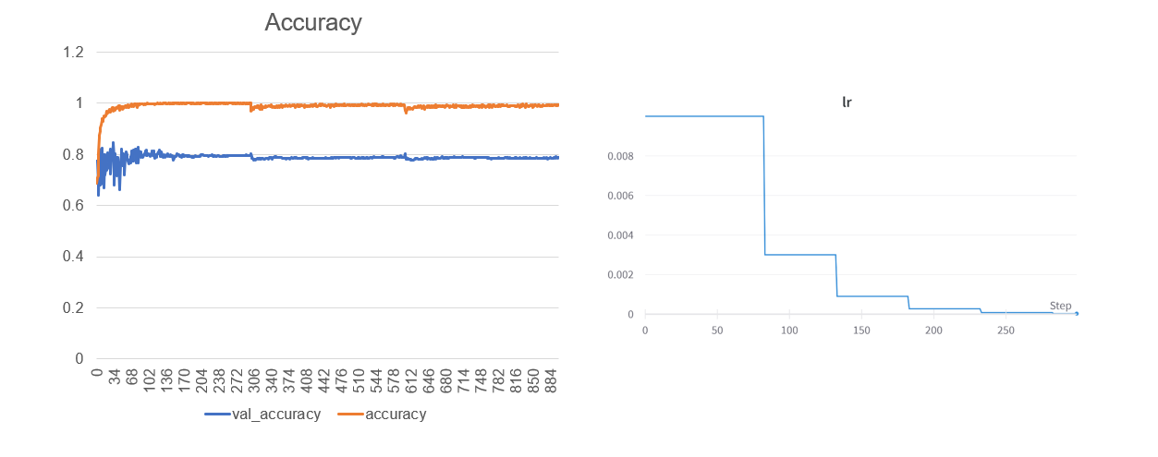
Video Based Model CNN Training Graphs

Slide 30
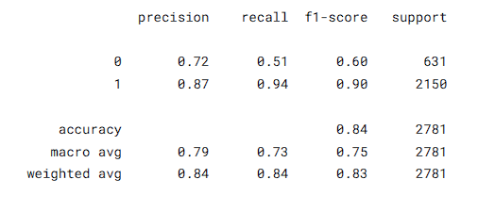
Video Based Model Results CNN
CASIA test Results

Slide 31
Liveness Models
Out of our four tested Model we decided to use the Frame based ones together as they preformed well in our testing.
The Volumetric CNN model did produce good testing accuracy but in Realtime and when tested on our faces it’s performance and accuracy fall off.

Slide 32
System Overview
In this section we will talk about all the tools used in our system as well as include flowcharts for examples.

Slide 33
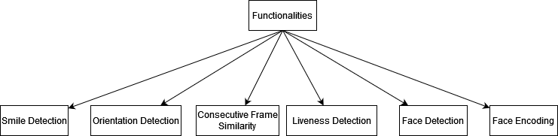
Tools and Functionalities

Slide 34
Smile and Orientation Detection
To detect smiles we are using OpenCV Cascade Classifier with haarcascade_smile.
To detect face orientation, we are using OpenCV Cascade Classifier with haarcascade_profileface.

Slide 35
Consecutive Frame Similarity
To detect any sudden change in ROI detected we use calculate KL Divergence of Histograms of consecutive frames.
If KLD > 0.3 then a sudden change occurred.

Slide 36
Liveness Detection
Out of our four tested Model we decided to use the Frame based ones together as they preformed well in our testing.
We take the average score of Real from each model and only accept the person if the score is more than 0.7.

Slide 37
Face Detection
It is based on Single-Shot-Multibox detector and uses ResNet-10 Architecture as backbone. The model was trained using images available from the web, but OpenCV provides 2 models for this face detector:
Floating point 16 version of the original caffe implementation.
8-bit quantized version using TensorFlow.
We are using the caffe implementation

Slide 38
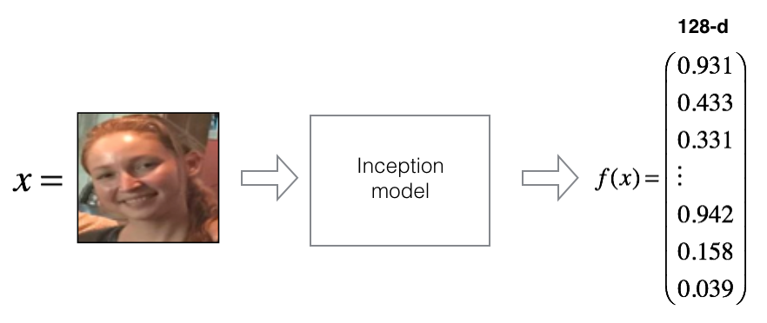
Face Encoding
We are using pretrained FaceNet Inception Model to encode Faces into vectors.
Then we compare incoming encoded face with the encoded faces in the database using cosine distance with a threshold of 0.07 for acceptance.

Slide 39
Flask and SocketIO
We used Flask as it is widely known to facilitate experimentation to a high degree.
In most cases, SocketIO connection will be established with Web Socket, providing a low-overhead communication channel between the server and the client.

Slide 40
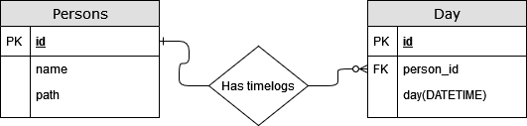
Database
We are using a simplistic database to keep track of users and time log their successful attempts.

Slide 41
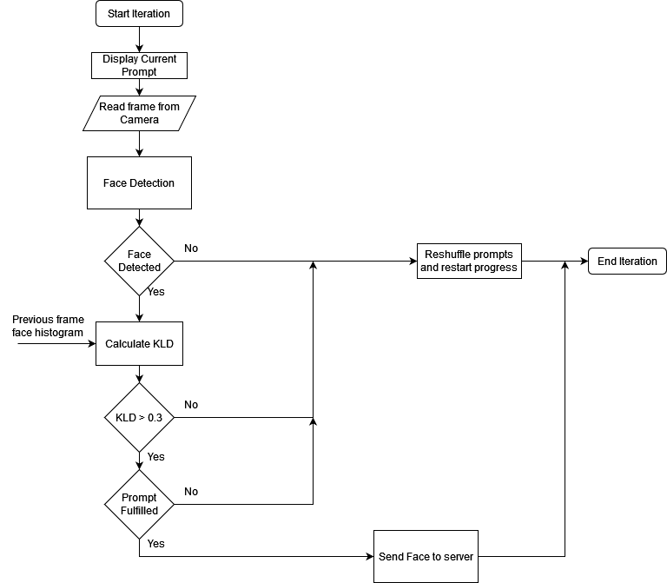
Client Side
This Flowchart summarizes client-side operation of each frame read from the webcam.

Slide 42
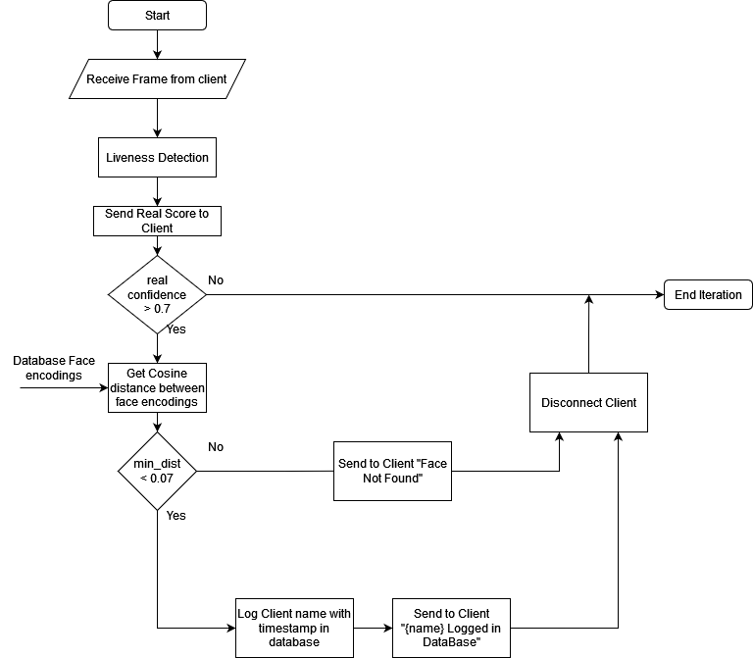
Server Side
This Flowchart summarizes server-side operation of each frame received from client.

Slide 43
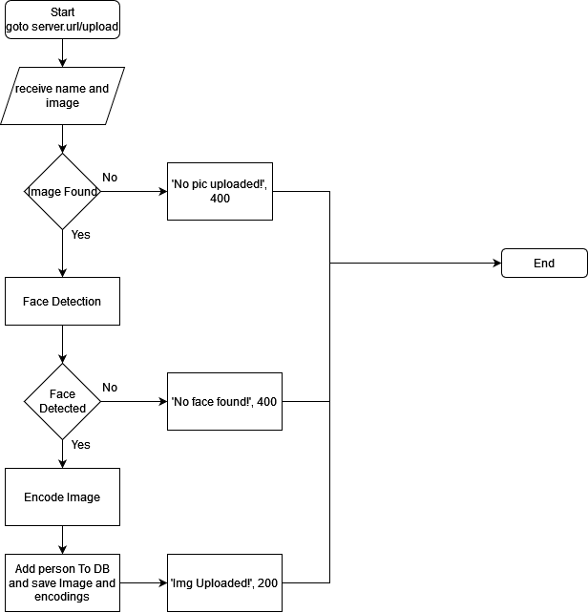
Register a new face in the database
This Flowchart summarizes registration of a new face in the data base.

Slide 44
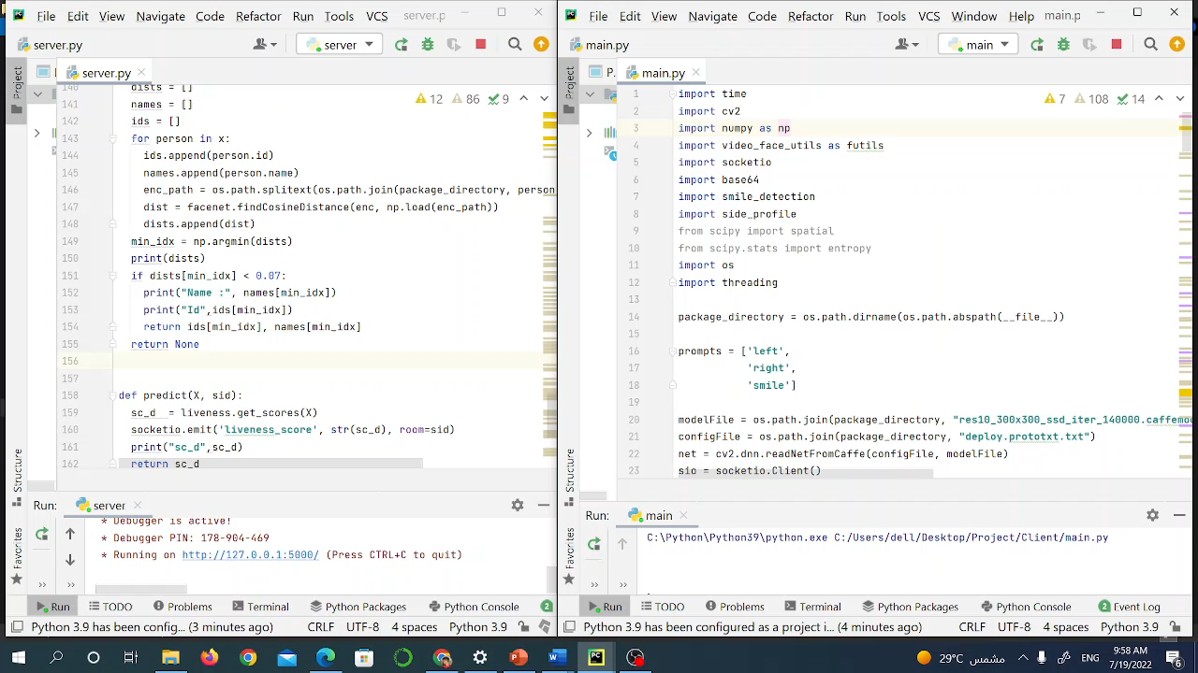
Video Demo

Slide 45
References
[1] Goode Intelligence, I. R. (2021, 4 19). Retrieved from https://www.businesswire.com/news/home/20210419005112/en/Goode-Intelligence-and-ID-RD-Announce-2021-Biometric-Survey-Results
[2] Peter. (2018, 3 12). Spiceworks. Retrieved from https://community.spiceworks.com/security/articles/2952-data-snapshot-biometrics-in-the-workplace-commonplace-but-are-they-secure

Slide 46
Thank you

